Slide 1
Parameter recovery using remotely sensed variables
Proctor, Carleton and Sum

Slide 2
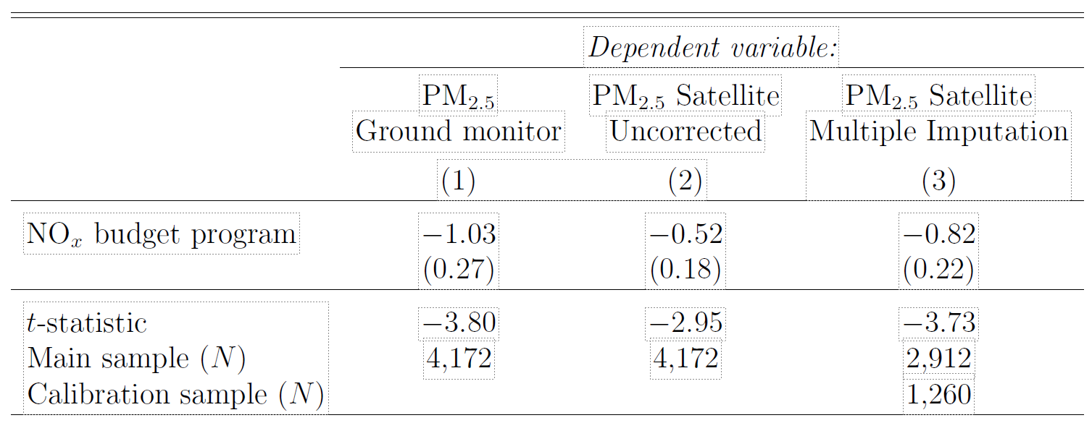
Remote sensing error can substantively affect estimates
mean reversion
classical measurement error
non-classical measurement error

Slide 3
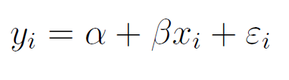
Set up
Assume the researcher wants to estimate:
but only has remotely sensed data for y, and/or x
assume that they have some groundtruth data of the remotely sensed variable
Notes:
assumes the model is correctly specified
Coverage is calculated by the fraction of the 100 bootstrap runs that contain the groundtruth estitmate

Slide 4
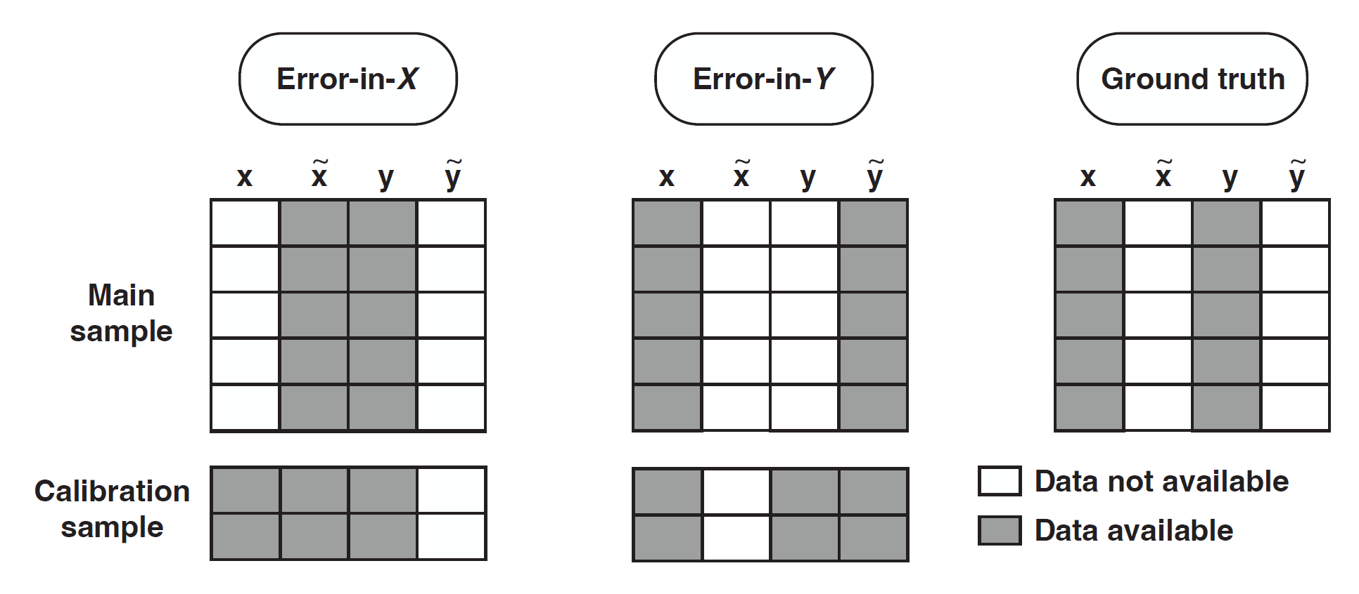
scenarios

Slide 5
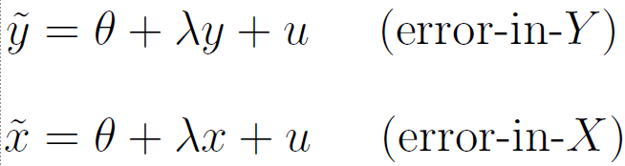
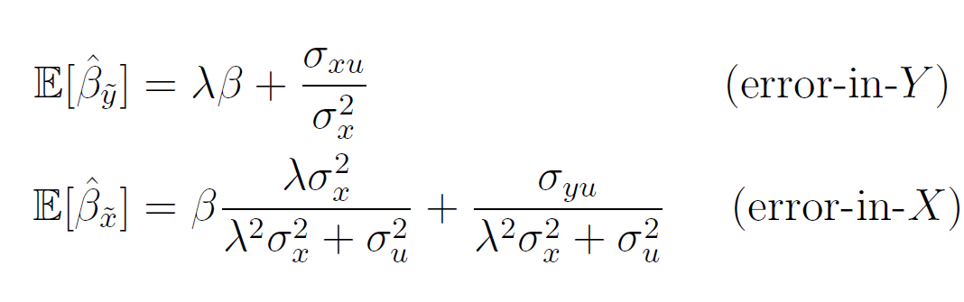
linear measurement error
If the form of the error is linear measurement error:
it would give the following bias:
Notes:
They find in their data, lambda < 1, and that it’s not classical

Slide 6
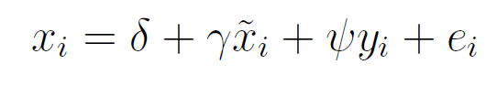
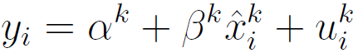
multiple imputation
Estimate a (e.g. linear) first stage model from the calibration (ground truth) set
Next, use the estimated parameters to predict xi where groundtruth does not exist.
Repeat using bootstrapping or estimating the above using Bayesian linear regression, where K coefficient draws are taken from a posterior distribution, generating x^{k}.
Run the second stage regression using each of these x^{k} , K times
Notes:
Estimated coeﬃcients from Equation 3, which is called the imputation step, describe how the remotely sensed proxy relates to the ground truth measurement, conditional on the
outcome variable For example, when extreme values of x are routinely underestimated,
as is common in remotely sensed estimates (e.g., see Figure B.2), γˆ is greater than one. Next, the estimated relationship from Equation 3 is used to impute a “corrected” value
of x˜ in the main sample, where ground truth measurements x do not exist. Call this prediction xˆ.
Note that the standard errors from stage 2 incorporate the errors in imputation

Slide 7
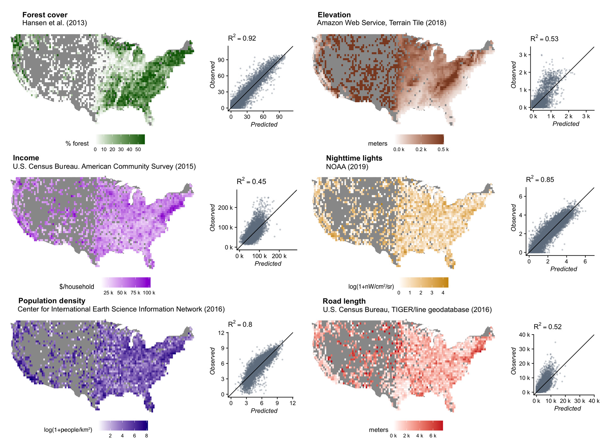
Data
Notes:
1 x 1 km

Slide 8
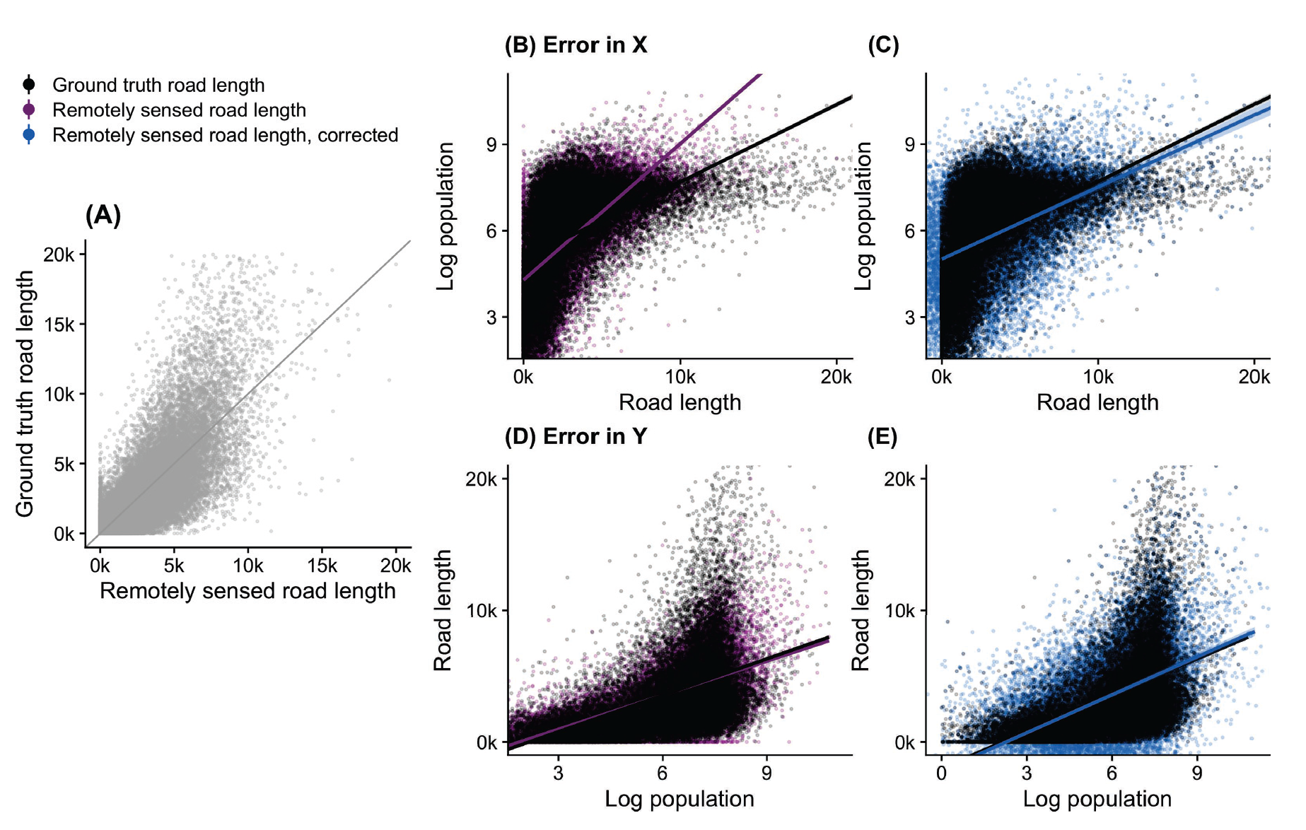
Notes:
Figure 3: Remotely sensed predictions introduce bias in parameters recovered in downstream regression analyses: example from predictions of road length. Figure uses ground truth population data and remotely sensed predictions of road length to illustrate how measurement error in remotely sensed predictions can bias downstream regression coeﬃcients and estimated standard errors. Panel (A) shows ground truth ob-
servations of total road length within 1km ⇥ 1km grid cells on the y-axis, plotted against satellite-based predictions of total road length on the x-axis. Panel (B) shows that the
measurement error evidenced in panel (A) leads to a biased estimate of the relationship between population density and road length. Panel (C) shows data points and a regres-sion model both adjusted using multiple imputation to correct the bias introduced by remotely sensed road length. Panels (D) and (E) repeat these analyses in an “error-in-Y ” model in which remotely sensed road length is the outcome variable and population density is the independent variable. In this case, bias from measurement error is minimal, but multiple imputation corrects for overly precise standard error estimates.

Slide 9
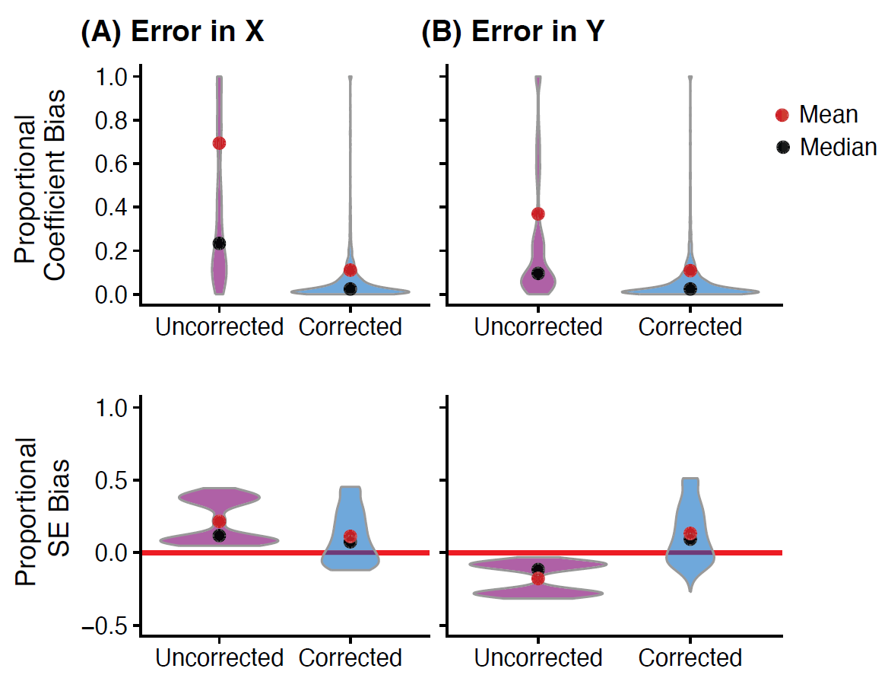
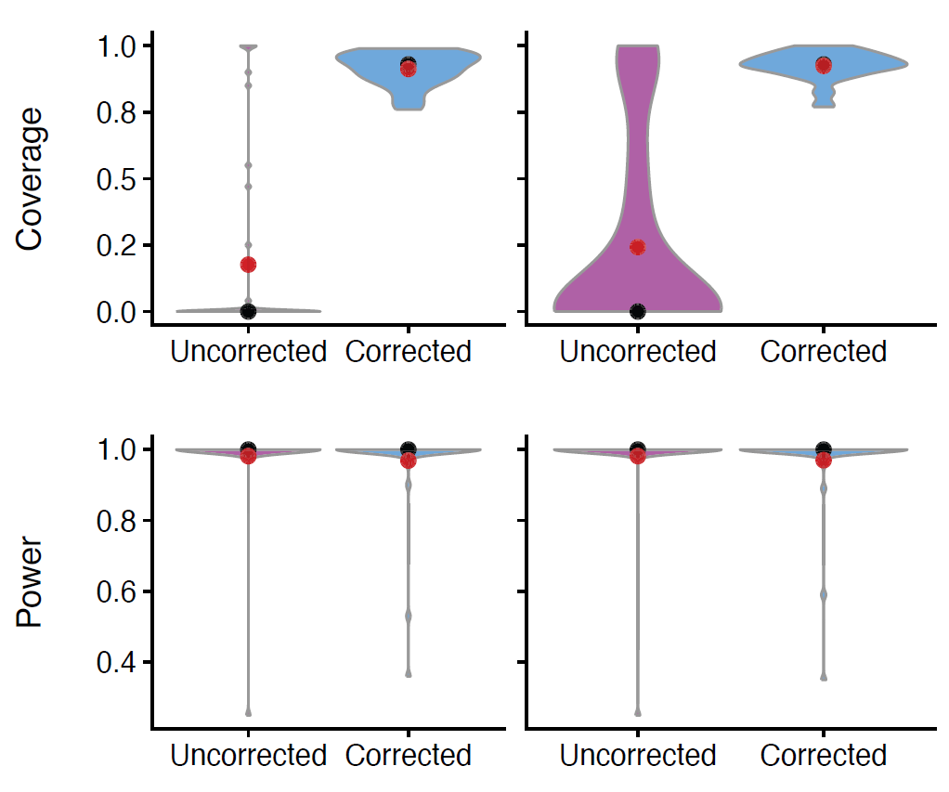
imputation approach reduces bias and increases coverage
Notes:
Figure 4: Bias, coverage, and power for regression models using remotely sensed variables both with and without correction via multiple imputation. Figure shows the distribution of bias, coverage, and power over a set of 100 bootstrapped estimates of 40 regression models, each of which estimates the relationship between two so-cioeconomic and/or environmental variables (e.g., income and temperature; road length and forest cover). Purple distributions indicate regression models in which remotely sensed variables are used without correction as either a dependent (panel (A), “error-in-X”) or independent (panel (B), “error-in-Y ”) variable, while blue distributions indicate regression models in which multiple imputation was used with a corresponding calibra-tion set to correct bias in recovered parameter estimates. The top two rows show the proportional bias in regression coeﬃcients and standard errors (where 0.25 indicates a 25% bias), while the bottom two rows show coverage and power. Data for violin plots has been winsorized for visual display purposes only.

Slide 10
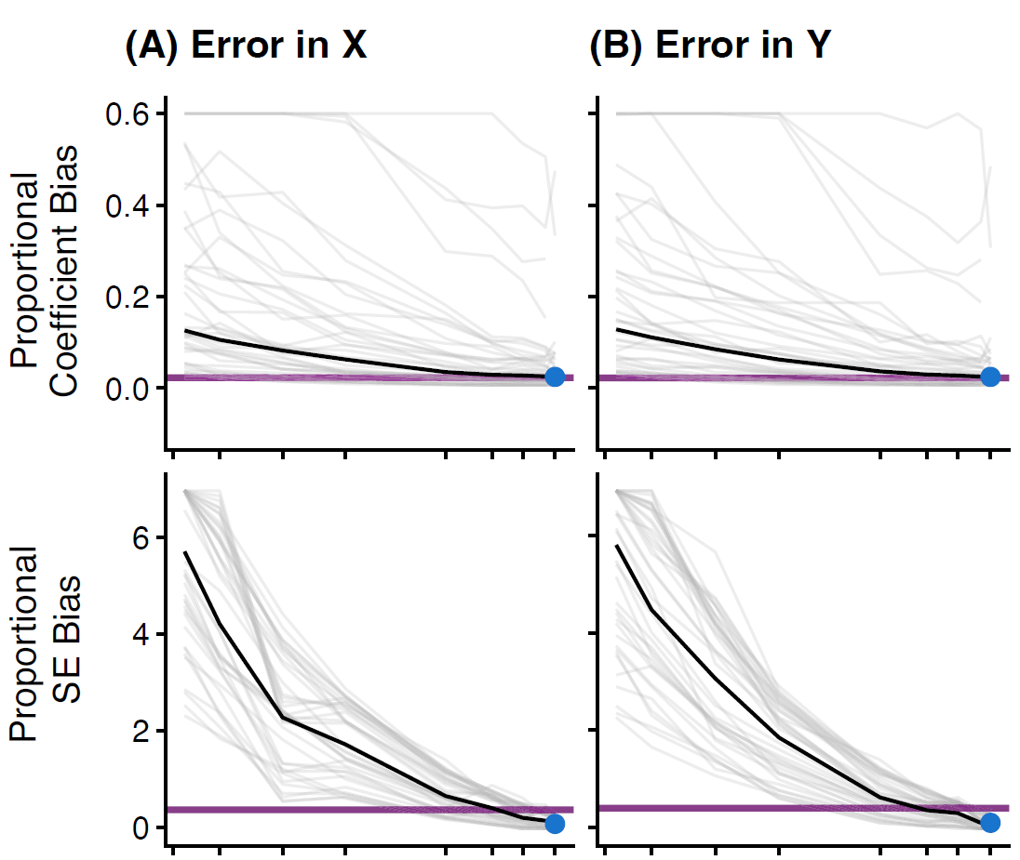
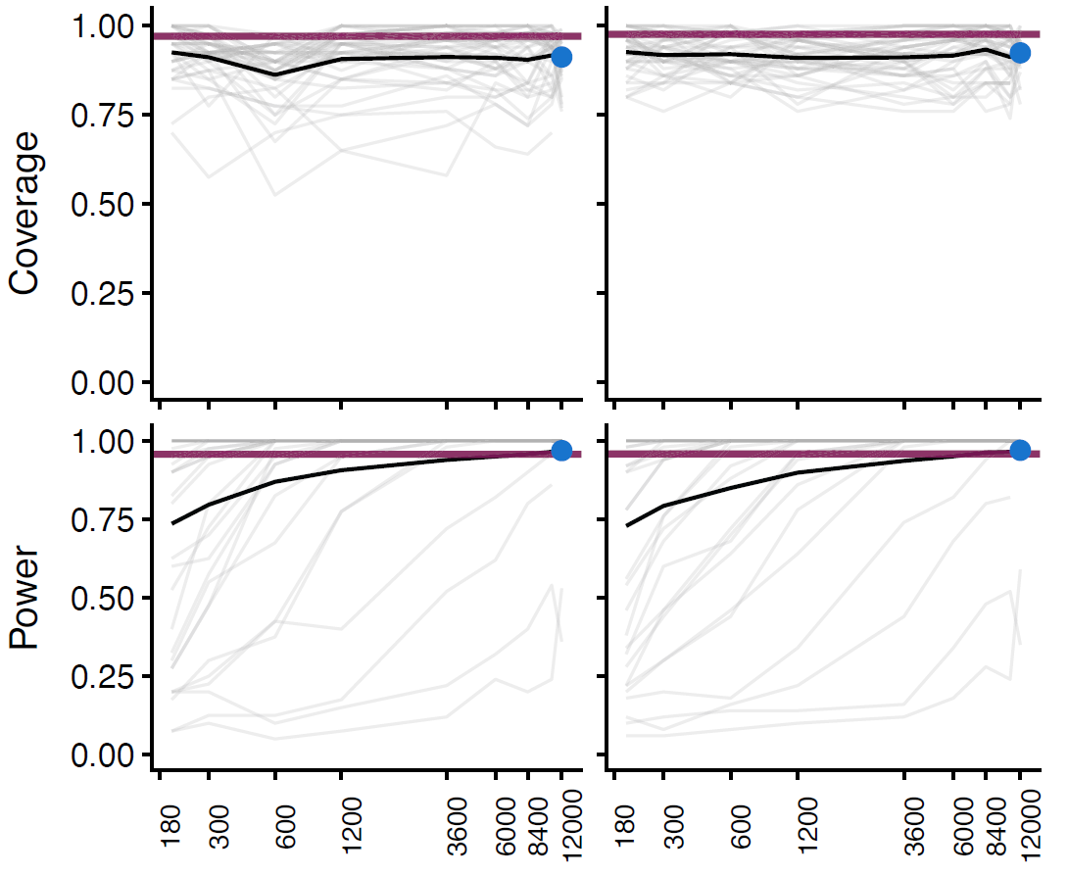
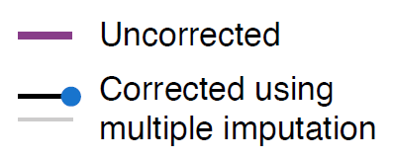
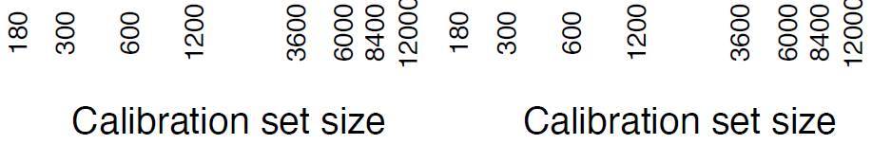
Notes:
Figure 5: The eﬀect of calibration set size on the ability of multiple imputation to correct biases introduced by remotely sensed variables. Figures show median bias, mean coverage, and mean power as a function of the size of the dataset available for calibration in the multiple imputation procedure. Horizontal purple lines show values for the uncorrected model, which does not rely on a calibration set. Solid black lines show median bias and mean coverage and power values across all regression models. Light grey lines show these measures for each of 40 regression models estimating the relationship between two socioeconomic and/or environmental variables (winsorized for display). Blue dots indicate values for a calibration set size of 12,000, as is used throughout the rest of the analysis (e.g., in Figure 4). As in Figure 4, panel (A) shows results for regressions in which remotely sensed variables are used as independent variables (i.e., “error-in-X”), while panel (B) shows results for regressions in which remotely sensed variables are used as dependent variables (i.e., “error-in-Y ”).

Slide 11
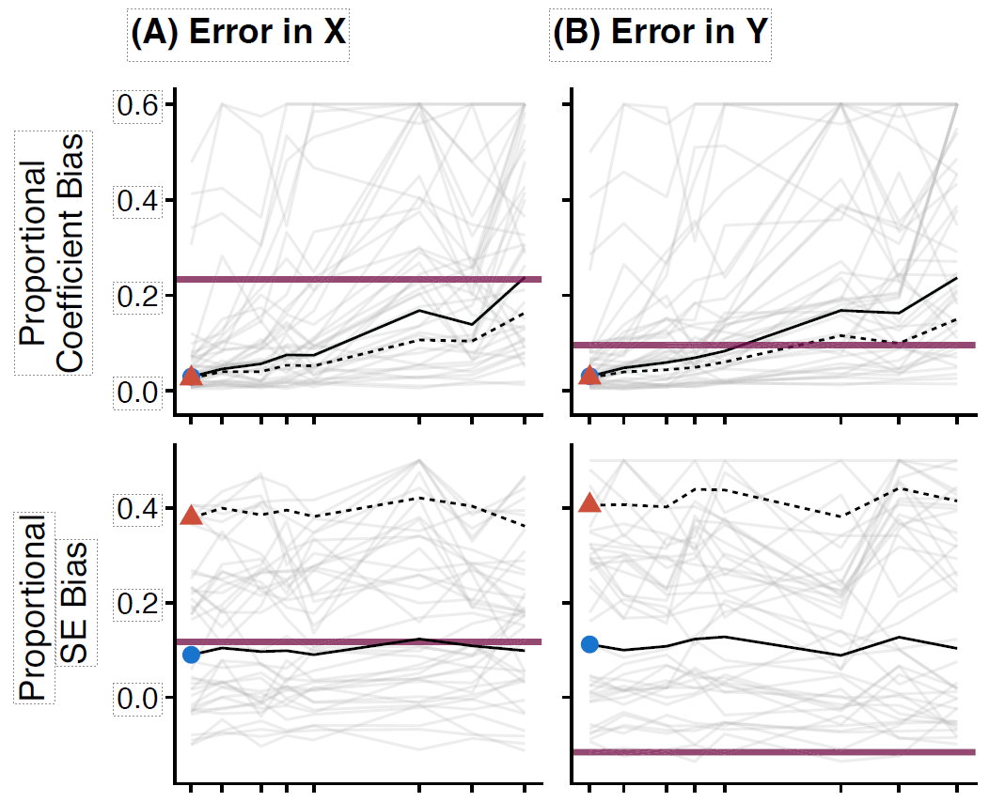
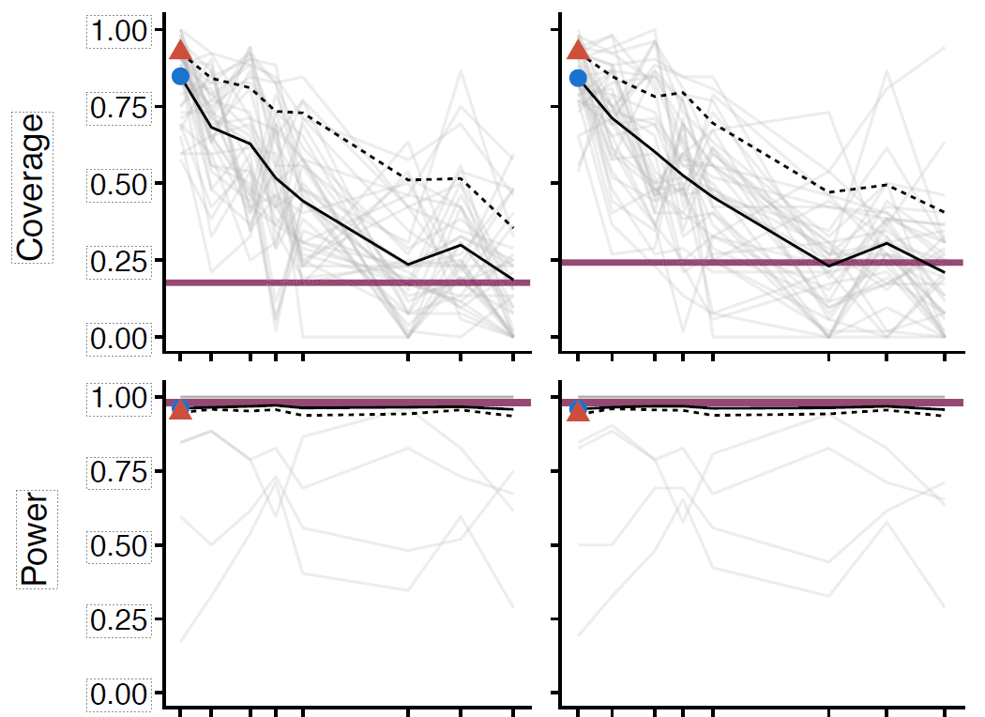
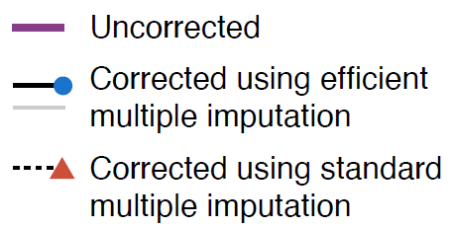
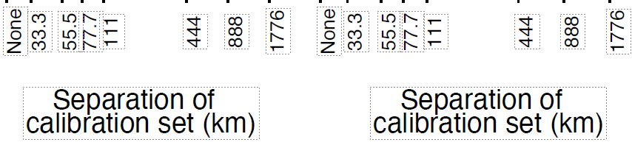
Notes:
Figure 6: The eﬀect of distance between calibration and main datasets on the ability of multiple imputation to correct biases introduced by remotely sensed variables. Figures show median bias, mean coverage, and mean power as a function of the distance between the calibration set and the main regression sample. Horizontal purple lines indicate values for the uncorrected model, which does not rely on a calibration set. Solid black lines show median bias and mean coverage and power values across all regression models. Light grey lines show these measures for each of 40 regression models estimating the relationship between two socioeconomic and/or environmental variables (winsorized for display). Blue dots indicate average values for a random sampling of the calibration set (i.e., no spatial separation between calibration and main samples imposed). Dotted lines show values for a “standard” version of multiple imputation, where, unlike the “eﬃcient” version of multiple imputation used throughout the text, the calibration set is not appended to the main set when estimating the parameter of interest. As in Figure 4, panel (A) shows results for regressions in which remotely sensed variables are used as independent variables (i.e., “error-in-X”), while panel (B) shows results for regressions in which remotely sensed variables are used as dependent variables (i.e., “error-in-Y ”).

